Slide 1
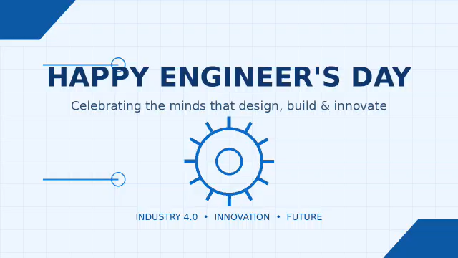

Slide 2
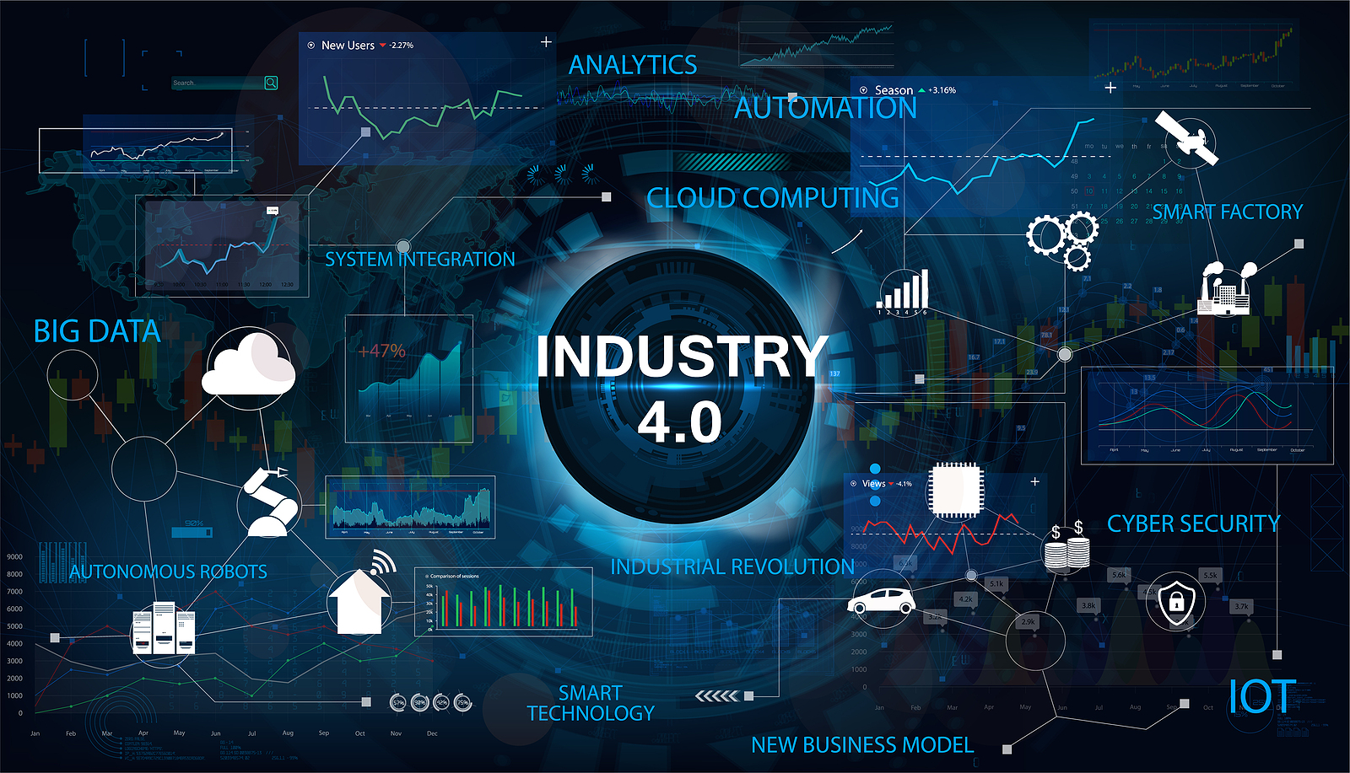
INDUSTRY 4.0
The Fourth Industrial Revolution & Smart Manufacturing
NAME:
SURYA (261096)
VIKKI (261095)
SAKET (261087)
ARYAN (261085)
Branch / Section: Computer Science & Engineering | Section B

Slide 3

Introduction to Industry 4.0
What is it? The integration of digital technology, AI, IoT, and cloud computing into traditional industrial and manufacturing practices.
Cloud & AI
Why is it important? It drastically increases operational efficiency, real-time data visibility, and enables hyper-customized mass production.
IIoT Network
Machines
Core Shift: Moves industries from centralized decision making to autonomous, decentralized smart systems.
Physical Plant
Industry 4.0 • 2

Slide 4



Basic Concept & Definition
Definition
Key Terms
Simple Explanation
The ongoing automation of traditional manufacturing and industrial practices using modern smart technology and machine-to-machine communication.
Cyber-Physical Systems (CPS), Internet of Things (IoT), Cloud Computing, and Cognitive Computing forming an interconnected grid.
Machines talking to machines without human intervention, analyzing data instantly, and optimizing production workflows autonomously.
Industry 4.0 • 3

Slide 5



Pillars of Industry 4.0
IIoT & Sensors
AI & Big Data
Cloud Computing
Connecting physical machinery to networks for constant monitoring, telemetry collection, and predictive maintenance alerts.
Analyzing massive data streams via machine learning algorithms to forecast faults and optimize supply chain routes dynamically.
Providing scalable storage and computing power for enterprise-wide data collaboration and remote plant tracking.
Industry 4.0 • 4

Slide 6
Smart Factory Architecture
Data Flow Pipeline
Dashboards
1
Smart Sensors & Actuators collect physical metrics.
Cloud & AI
2
Edge / Gateway aggregates raw telemetry safely.
Edge / Gateway
3
Cloud & AI Models perform deep analytics.
Sensors & Actuators
4
Actionable Dashboards drive enterprise execution.
Industry 4.0 • 5

Slide 7



Real-Life Applications
Predictive Maintenance
Smart Supply Chain
Collaborative Robots
Sensors detect motor wear-and-tear before a failure happens, avoiding costly line downtime and emergency part orders.
Autonomous inventory tracking and smart contracts ensure raw materials arrive precisely when assembly lines need them.
Cobots work safely alongside human operators in assembly lines, handling tedious lifting and precision welding.
Industry 4.0 • 6

Slide 8

Advantages & Limitations
Advantages
Limitations
Higher productivity and output speed
High initial capital investment for retrofitting
Real-time error detection and quality control
Critical cybersecurity and data privacy risks
Optimized resource and energy management
Requirement for highly skilled technical workforce
Flexibility for customized production runs
Industry 4.0 • 7

Slide 9
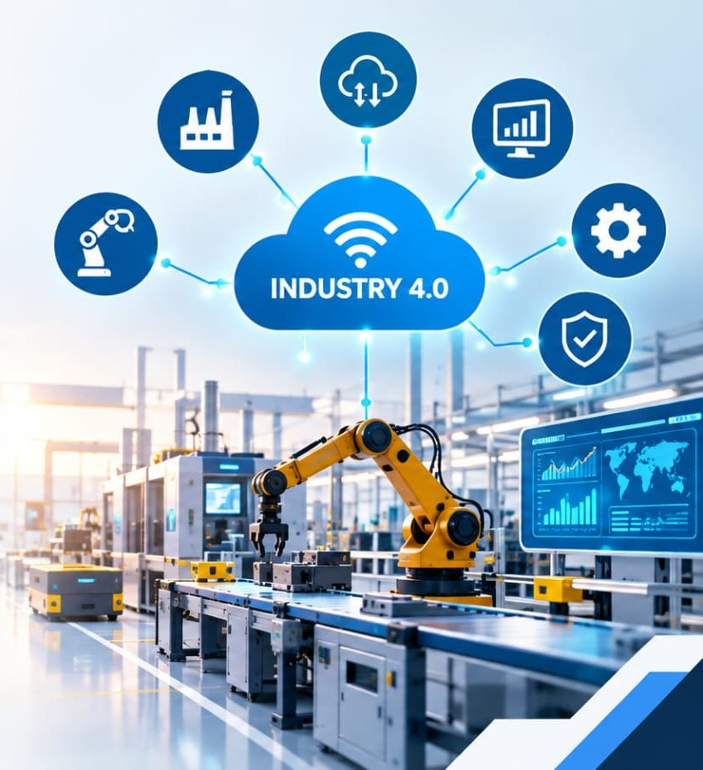

Conclusion
What did we learn? Industry 4.0 transforms conventional factories into intelligent ecosystems using connectivity, computing, and automated insight.
Future Outlook: Embracing these technologies is no longer optional for modern enterprises aiming to stay competitive in a globalized digital market.
Industry 4.0 • 8

Slide 10
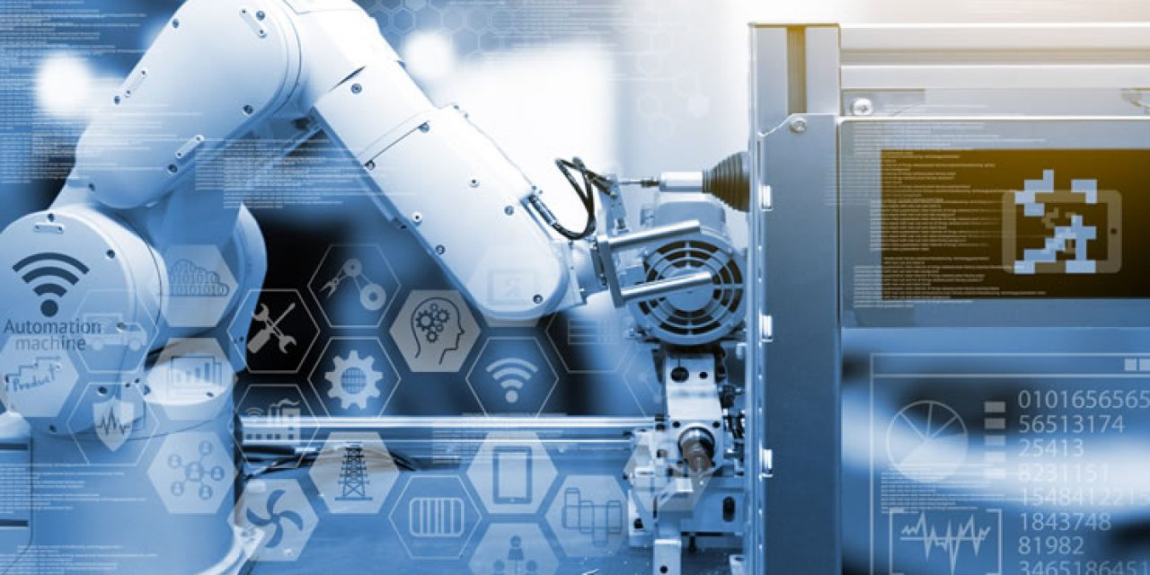
References
Source Type | Title / Detail | Author / Platform
Book | Industry 4.0: The Industrial Internet of Things | Dr. Alistair Gilchrist
Website | World Economic Forum (WEF) Industry Insights | weforum.org
Article | The Future of Manufacturing Excellence | Harvard Business Review
Industry 4.0 • 9

Slide 11

Thank You!
IN THE GUIDENCE OF SHIVANI MAM

